Slide 1
SENG 422 Lab 4 Cloud Computing
Time: ELW B220 from (4:00 - 6:50) every Tuesday
TA: Philip Baback Alipour
Ph.D. Candidate in Electrical, Computer Engineering and Quantum Physics,
Dept. of Electrical and Computer Engineering, University of Victoria, CA
Email: philipbaback_orbsix@msn.com
Office: ELW Room # A358

Slide 2
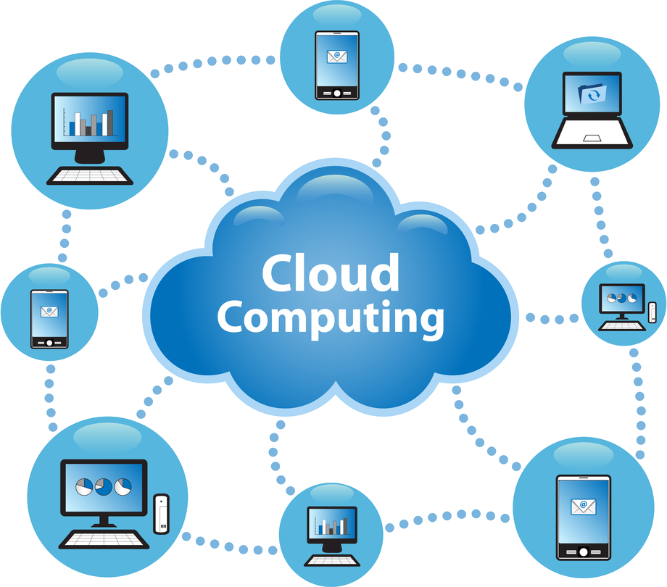
Cloud Computing

Slide 3
Benefits of Cloud Computing
Cost
Agility
Device and Location Independence
Reliability
Scalability
Performance
Security

Slide 4
Some Cloud Solutions
MS Windows Azure
Google App Engine
Amazon EC2

Slide 5
MS Windows Azure
Open cloud platform that enables you to quickly build, deploy and manage applications across a global network of Microsoft-managed datacenters.
Languages that can be used: Java, PHP, node.js, .Net and others (python).

Slide 6
Google App Engine
Google App Engine enables you to build and host web apps on the same systems that power Google applications. App Engine offers fast development and deployment; simple administration, with no need to worry about hardware, patches or backups;and effortless scalability.
Languages that can be used: Java, Python, and Go (experimental).

Slide 7
Amazon EC2
Amazon Elastic Compute Cloud is part of Amazon Web Services.
Amazon Elastic Compute Cloud (Amazon EC2) is a web service that provides resizable compute capacity in the cloud. It is designed to make web-scale computing easier for developers.
Languages that can be used: Java, PHP,.Net, Python, and Ruby

Slide 8
Google Web Toolkit (GWT)
Amazon Elastic Compute Cloud is part of Amazon Web Services.
Amazon Elastic Compute Cloud (Amazon EC2) is a web service that provides resizable compute capacity in the cloud. It is designed to make web-scale computing easier for developers.
Languages that can be used: Java, PHP,.Net, Python, and Ruby

Slide 9
Google Web Toolkit (GWT) Things Needed
Java 6 Run-time
Eclipse IDE
Google Plugin for Eclipse (GPE) along with GWT and App Engine SDKs
GWT Designer

Slide 10
Create New Web App
Simply File->New-> Web Application Project
Name your project
Add some code
GWT Designer
Run locally/Debug
Run in Production Mode
Deploy to App Engine

Slide 11
Cloud Storage
App Engine DataStore
provides schemaless storage for your app
Google Cloud SQL
provides relational SQL database for your App based on MySQL
Google Cloud Storage
provides a storage service for objects and files terabytes in size

Slide 12
App Engine DataStore
App Engine DataStore is schemaless with query engine and atomic transactions.
App Engine SDK for Java includes implementation for Java Data Objects (JDO) and Java Persistence API (JPA)

