Slide 1
A Real-time Cargo Damage Management System via a Sorting Array Triangulation (SAT) Technique
Presentation by:
1 Philip B. Alipour
2 Matteus Magnusson
3 Martin W. Olsson
4 Nooshin H. Ghasemi

Slide 2
Problem Description
1. Cargo damage could happen anywhere
2. Weak support system during transport
3. Inspect and profile the damaged from undamaged
4. Parameters are:
cargo stack population n,
suggested containers stack for inspection S = (xy_{i}) from {xy₁…, xy_{n}}
cargo status or detected D_{xyz} = Red or Grey or Green
time to detect t_{i}, total time to generate status T_{D}, saved time T_{saved} by SAT vs. time if used by other techniques, T_{other}.
5. Parametric adaptations: f_{local} = xy_{i} coordinates for stack location, xyz for physical volume exposures (leakages) and damaged surfaces

Slide 3
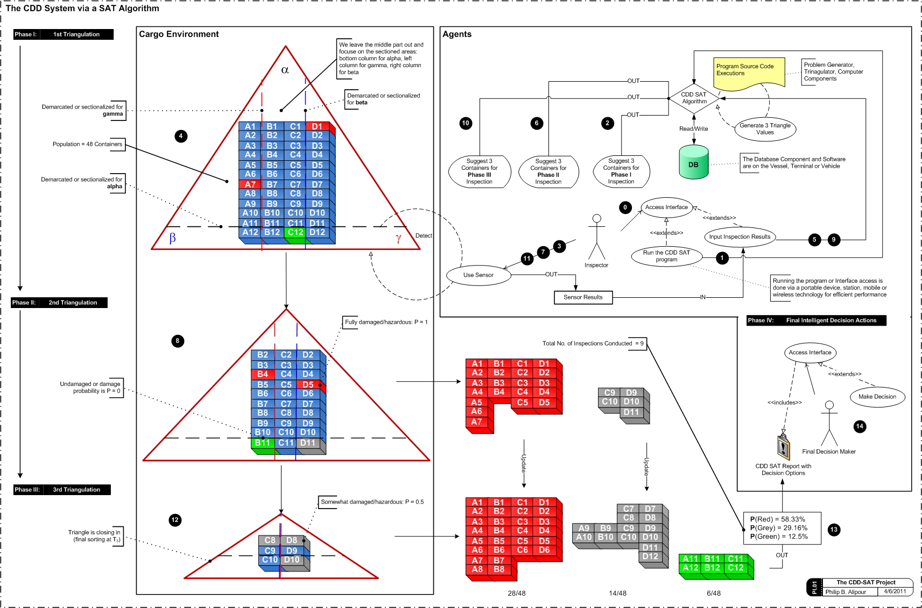
Problem Design & Objectives
Detect Defected or Damaged Cargos (ranging from low to severe)
Sort Damaged from Undamaged Cargos
Suggest Specific Containers from the Sorted List
Manage Cargos by human and non-human agents:
Detectors mounted onto the crane facility in port;
Detectors stationed on the vessel after cargo load
Finalize results as a report for a Final Managerial Decision, saying:
Don't get wined up with the details, rather matches of the results in the database, inputs, outputs and updates coming from the algorithm.
Correct input gives correct output estimates probabilistically, either in form of more estimates otherwise precisions.

Slide 4
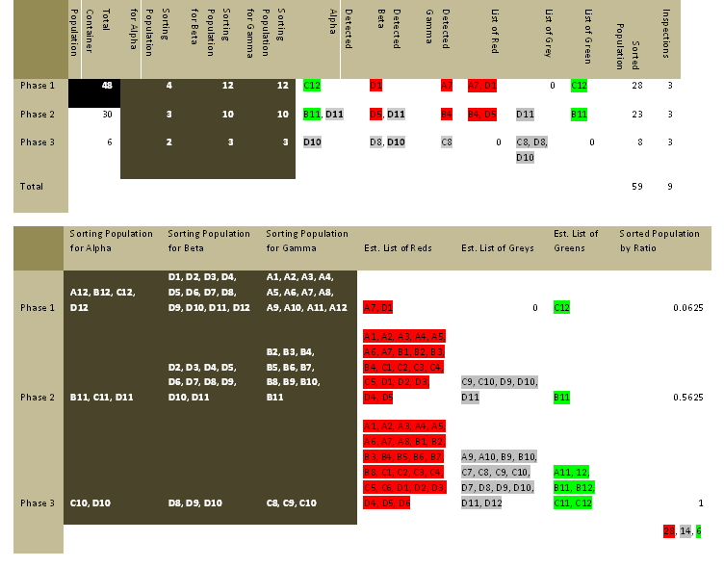
Solution Method for DSS
Our simulation method integrates regular and quasi-Monte Carlo methods for computing each triangulation phase:
We Define a domain of possible inputs on i as (x₁y₁, …, x_{n}y_{n})
Generate inputs randomly from a probability distribution over the domain (2D Array) giving x_{i} * y_{i}.
Random Function f(n) = Rnd(i)
We inspect cargo i for one triangle side (α),
Two more i’s for the remaining triangle sides (β and γ)
We generate an estimate between the detected 3, using distances to the remaining adjacent stacks in a database
We aggregate and update the results from one SAT phase to another on the whole population.

Slide 5
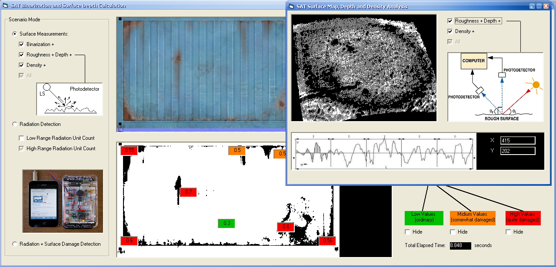
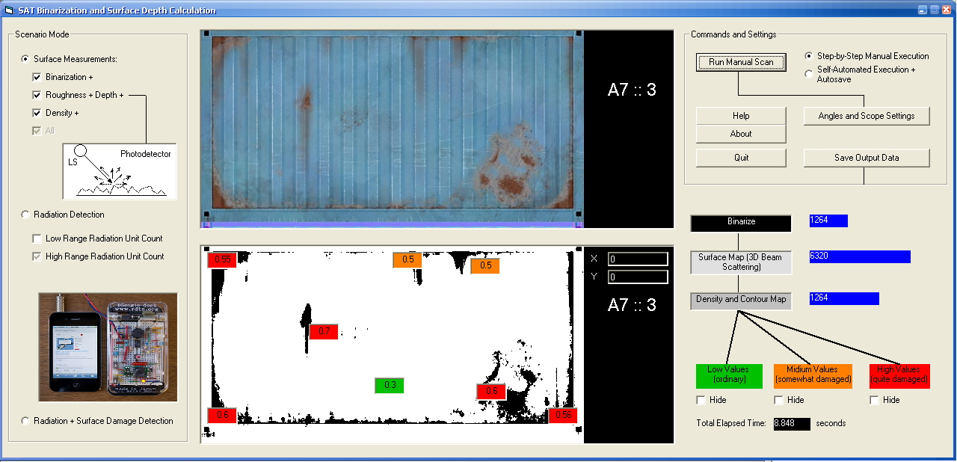
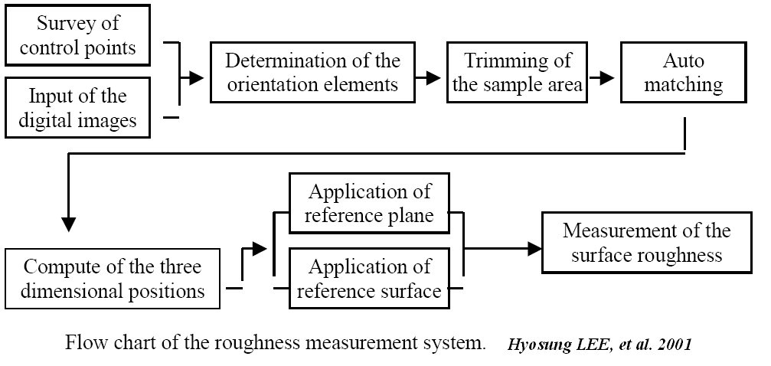
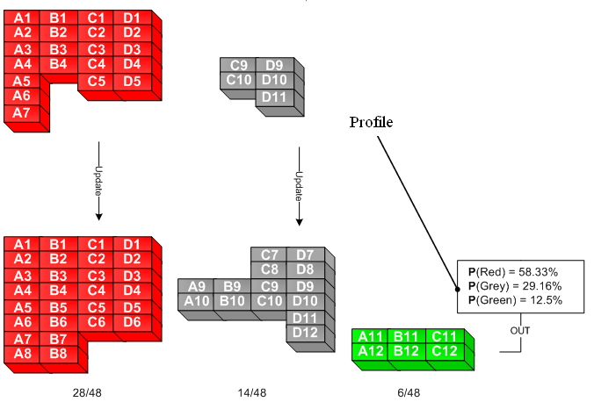
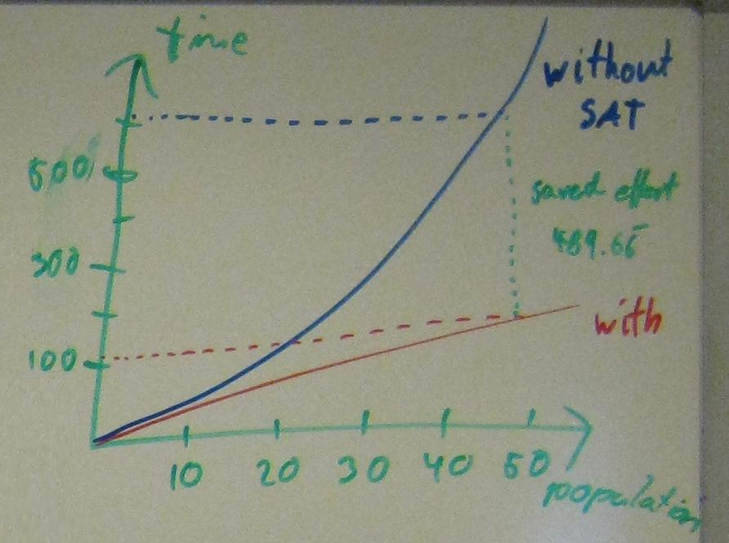
Solution Method for DSS
The (red, grey, green) status ratio is then computed out of the whole stack population to generate the final status profile on cargos
Optimization is mainly on the performance time relative to DB information updates and detection parameters. Here is an example from the main plan
Saved Time Effort:
T_{saved} = T_{other} - T_{D}
602.66 s
113 s

Slide 6
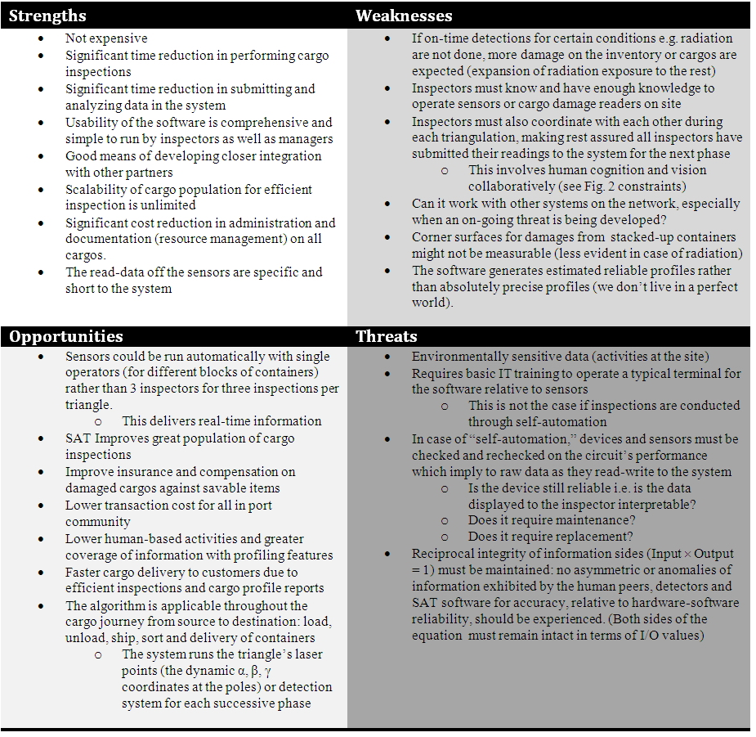
STATUS
Current project status and problems:
Program results on the hybrid simulation
Profile generation and phase-to-phase triangulation estimates on cargo status
Further analysis to our conducted SWOT analysis, like sensitivity analysis on the time and spatial factors (performance)
This results in assessing and tackling Uncertainties in the project
This further results in Verification and Validation of our incorporated technique.

Slide 7
Q & A

