Slide 1
An Introduction and Evaluation of a Fuzzy Binary AND/OR Compressor
An MScThesis
By: Philip Baback Alipour and Muhammad Ali
BTH University, Ronneby Campus, Sweden
May 27, 2010

Slide 2
Introduction and Background
What is data lossless compression?
The schematic algorithm for a compressor looks like this:
Why not lossy compression instead of lossless (LDC)?
The algorithms and LDC packages we know of:
The ranked ones for LDC: WinZip, GZip, WinRK; the list goes on… For more information, visit:
www.maximumcompression.com
Input
Data
Encoder
(compression)
Decoder
(decompression)
Output
Data
Storage or
networks

Slide 3
Introduction and Background
What is their logic? Quite probabilistic (repeated symbols) i.e. frequent symbols or characters in Information Theory:
e.g., aaaaaaaaaaaaaaabc in the original text → 15[a]bc in the compressed version.
Thus, Length (original string) = 17 bytes and Length (compressed string) = 7 bytes , we thus say
(7 ×100)/17= 100 – 41.17 = 58.82% compression has occurred.
What is their entropy? Shannon entropy
What about the FBAR algorithm?
Is there a difference between FBAR and other LDCs?
The answers is Yes: in Logic, Design and Performance

Slide 4
FBAR Logic for Maximum LDCs
What is FBAR?
A Combinatorial Logic Synthesis solution in uniting Fuzzy + Binary via AND/OR operations
What’s the catch?
Uniting highly probable states of logic in information theory to reach predictable states i.e.
Uniting Quantum Binary + Binary via Fuzzy
What is Binary? Imagine data as a sequence of 1’s and 0’s
ON Switch or Heads, OFF Switch or Tails
What is Fuzzy? Imagine data as a sequence of in-between 1’s and 0’s including their discrete representations

Slide 5

FBAR Logic for Maximum LDCs
What is Quantum Binary?
Imagine a flipping coin that never lands and continues to flip forever!
The analogy is, it is either 1 or 0, or both (highly dual/probabilistic):
having {00, 11, 01, 10} states simultaneously
Why FBAR?
To achieve double-efficient data as great as possible during data transmission. This is called superdense coding;
e.g., 2 bits via 1 qubit. In our model, is: 16 bits via 8 bits or a minimum of 2 chars via 1 char contained, or, a 50% LDC.
For the moment, very hard and complex to implement. Why?
∞

Slide 6
FBAR Logic for Maximum LDCs
The key is in applying impure (i), pure (p) and fuzzy transitive closures to bit pairs (pairwising FBAR logic):
Really simple:
p is either 11 or 00; the closure of this is simple to predict: it is 1 for 11 since AND/OR of 11 is 1, and 0 for 00 is similar .
i is either 01 or 10; this is the major problem since it closes with either 1 for 01, or 0 for 10, which coincides with p conditions of 11 and 00 in bit product.
Solution: we first consider a pure sequence of bits and manipulate it with ip, then its result by zn combinations.
z for zero or ignore e.g., z(01) = 01, z(10) = 10
n for negate e.g. n(01) = 10, n(11) = 00, and etc.

Slide 7
FBAR Logic for Maximum LDCs
1. This is a pure sequence for the input chars. We set this always as default in the FBAR program
11111111
2. Suppose the original input char is
@
3. In binary according to ASCII is
01000000
4. So the combination in terms of znip relative to pure sequence closures on each pair from MSB to LSB, is
i p p p (11 11 11 11) → 01 11 11 11 → then
z n n n (01 11 11 11) → 01 00 00 00 → @

Slide 8
The 4D bit-flag Model
We put all of our emerging 1-bit znip flags in unique combinations for double efficiency.
Solution: We intersect them with another znip’s representing a second char input:
C(2chars) = 2 znip = (4 bits OR 4 bits) x (4 bits OR 4 bits) ≤ 8 bits (Dynamic approach)
C(2chars )= 2 znip=(4 bits x 4 bits) x (4 bits x 4 bits) = 8 bits in 1x1x1x1 to 16x16x16x16 address (Static approach)
The latter approach literary creates 4 dimensions in the given address range.

Slide 9
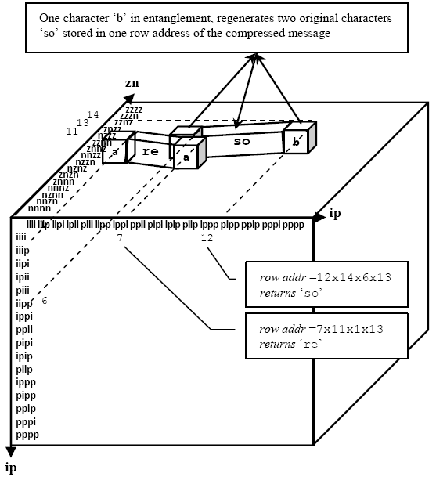
The 4D bit-flag Model
reso
Now, we use znip to reconstruct data. But each occupies a single bit: z as 0, n as 1, i as 1 and p as 0,
So, we raise them in a static object (in a grid/portable memory) to occupy 1 static byte per combination only.
This is our model presenting 2^{(4×4)} = 2¹⁶ = 65,536 = 64K unique bit-flag combinations (or ASCII 256×256):
Compress
As
reso
a b
Decompress
As
The Program uses the Translation Table to return the originals
The Program stores ‘a’ and ‘b’ to a row # according to the translation table Org Char column

Slide 10
The 4D bit-flag Model
For highest doubled-efficiencies, we extend the number of znip columnar combinations.
This is called FQAR: (A strongly quantum oriented algorithm):
Table 1 Table 2 Table 3 Table 4
1x1x1x1 1x1x1x1 1x1x1x1 1x1x1x1
… … … …
16x16x16x16 16x16x16x16 16x16x16x16 16x16x16x16
It delivers double doubled-efficiencies, and thereby quadrupled efficiencies as well!
Commencing with 75%, thereby 87.5% compression, or, satisfying 65,536² = 4,294,967,296 = 4.1 GB and 65,536⁴ = 1.8 × 10¹⁹ = 15.61 EB combinations, respectively.

Slide 11
Process, LDC Dictionary and LDD
The following is our circular process on LDC and LDD
Original Data
AND/OR Application
Fuzzy Decision on Encoded Data
Compressed Data
Raise Flags in Memory/Grid
Reference Flags in Dictionary
Construct Bitwise Conditions
Decoded Data
LDD
(Original Data)

Slide 12
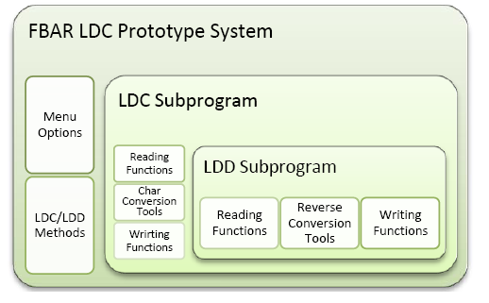
The Prototype
The FBAR prototype should cover all aspects of implementation satisfying algorithm’s structure
Load document
Compressed document
Reconstruct original document

Slide 13
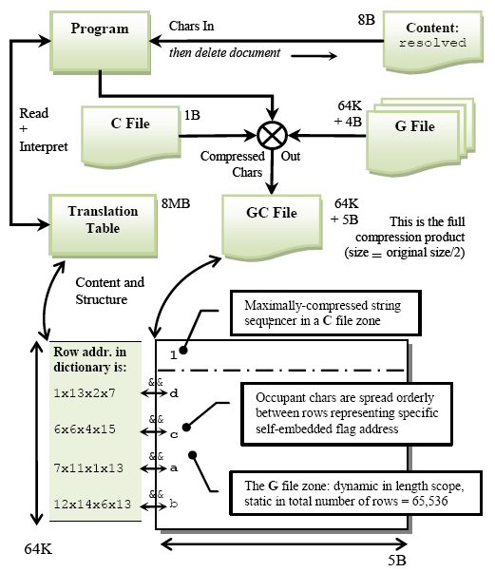
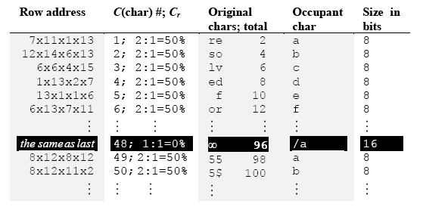
Process, LDC Dictionary and LDD
The column for a successful LDD
Chars that represent Original chars stored in a specific row of the G file
Here is the sample illustrating an LDC to LDD for 50% fixed compressions.
Double efficient LDD, accomplished
The program interprets these two columns in an if-statement returning Original chars.

Slide 14
Process, LDC Dictionary and LDD
The following is the actual translation table, static in size ≈ 8MB for the 1st version of double efficiency.
Row # | Bit-flag address | Customized 95 ASCII Chars as Occupant Chars representing the “Org.” column via the “4x1-bit flag address” column | Org. char
1 | 1x1x1x1 | abcdefghijklmnopqrstuvwxyzABCDEFGHIJKLMNOPQRSTUVWXYZ1234567890`~!@#$%^&*()-=_+[]{}\|;:'"/?.>,< | ª ª
2 | 1x2x1x1 | abcdefghijklmnopqrstuvwxyzABCDEFGHIJKLMNOPQRSTUVWXYZ1234567890`~!@#$%^&*()-=_+[]{}\|;:'"/?.>,< | ¥ ª
3 | 1x3x1x1 | abcdefghijklmnopqrstuvwxyzABCDEFGHIJKLMNOPQRSTUVWXYZ1234567890`~!@#$%^&*()-=_+[]{}\|;:'"/?.>,< | • ª
4 | 1x4x1x1 | abcdefghijklmnopqrstuvwxyzABCDEFGHIJKLMNOPQRSTUVWXYZ1234567890`~!@#$%^&*()-=_+[]{}\|;:'"/?.>,< | © ª
… | … | … | …
65534 | 16x16x16x14 | abcdefghijklmnopqrstuvwxyzABCDEFGHIJKLMNOPQRSTUVWXYZ1234567890`~!@#$%^&*()-=_+[]{}\|;:'"/?.>,< | ÿó
65535 | 16x16x16x15 | abcdefghijklmnopqrstuvwxyzABCDEFGHIJKLMNOPQRSTUVWXYZ1234567890`~!@#$%^&*()-=_+[]{}\|;:'"/?.>,< | ÿü
65536 | 16x16x16x16 | abcdefghijklmnopqrstuvwxyzABCDEFGHIJKLMNOPQRSTUVWXYZ1234567890`~!@#$%^&*()-=_+[]{}\|;:'"/?.>,< | ÿÿ

Slide 15
The Statistical Test and Performance
We tested our algorithm using nonparametric test.
We tried 12 samples and compressed them by 4 algorithms.
Reason:
The number of samples were < 20;
The data type was knows as char-based, hence the number of data types was limited (no extra assumptions like parametric methods)
Not subject to normality measurements, unlike parametric and t-test cases.

Slide 16
Results
LDC ratio comparisons between FBAR/FQAR and other algorithms

Slide 17
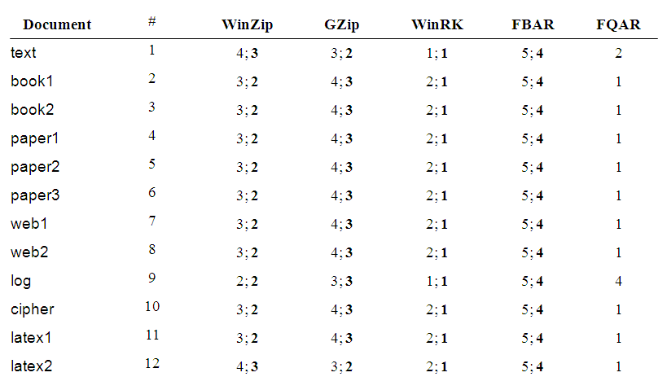
Results
One must not get fooled by having 50% ratios as 4th rank.
Because this 50% differs from percentages generated by other algorithms.
This 50% proves double efficiency. Others can not.
FQAR is based on FBAR translation table ranking 1st.
Current test case LDCs with ranks

Slide 18
Results
kBps
Bitrate comparisons between FBAR and WinRK

Slide 19
Results
MB
Memory usage comparisons between FBAR and WinRK

Slide 20
Contribution
Uniformity of relatedness of logic states i.e. FBAR /FQAR.
Incorporating fuzzy to unite binary with quantum; Eq. (1)
The 4D bit-flag Model. It is extendable based on,
2, 1, 0 bit/byte entropies, certainly denoting, 50% , 75% , 87.5% .
These percentages come from the FBAR entropy relation Eq.(6) of our paper. In fact, it’s quite novel and it works!
Next reports, negentropy relation elicited form Eq. (6) for a universal predictability.
Our model could solve probabilistic conditions due to its self-embedded, containment nature of bits in IT and QIT.

Slide 21
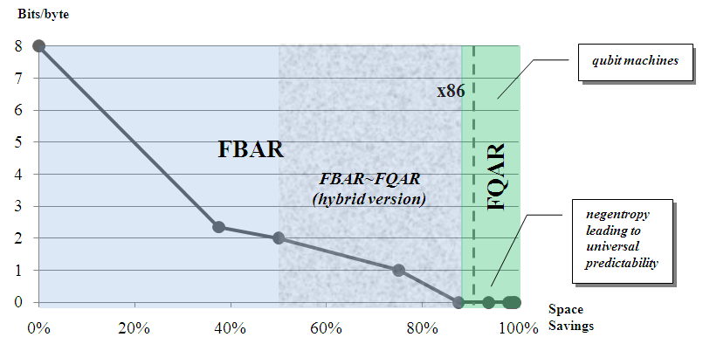
Discussion
The EB barrier
Is FBAR significant for its future usability?
What is the rate of its confidence?
Quite high, because its values are predictable and the confidence is rated based on predictability of spatial and temporal rates;
Thus, least likely to fail at all.
We have done this with the new model and algorithmic representation.
Why?
To perform maximal and thus ultimate LDCs.
Risks: It only fails if program functions are not implemented according to the model.
In other words, debugging and validation issues, is always the case during implementation.
The EB barrier by the 64-bit microprocessor for C_{r} > 87.5%.

Slide 22
Conclusions
We outlined and discussed the algorithm’s structure, process and logic.
It gave use a new field to study, as a new solution to computer information models, encryption, fuzzy, binary and quantum applications.
The algorithm, in its model, demonstrates double-efficiency,
Using regular probability methods is almost impossible for scientists to implement due to its overly complex logic.
The FBAR/FQAR model is a solution to complex problems in negentropy and non-Gaussian probability in statistics and other fields of mathematics.

Slide 23
References
D. Joiner (Ed.), ‘Coding Theory and Cryptography’, Springer, pp. 151-228, 2000.
English text, 1995 CIA World Fact Book, Lossless data compression software benchmarks/comparisons, Maximum Compression, at: http://www.maximumcompression.com/data/text.php
IBM (2008). A brief history of virtual storage and 64-bit addressability. http://publib.boulder.ibm.com/infocenter/zos/basics/topic/com.ibm.zos.zconcepts/zconcepts_102.htm . Retrieved on May 24, 2010.
P. B. Alipour and M. Ali 2010. An Introduction and Evaluation of a Fuzzy Binary AND/OR Compressor, Thesis Report, School of Computing, Ronneby, BTH, Sweden.
Thanks for your attention!

Slide 24

Questions

